Slide 1
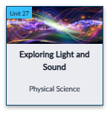
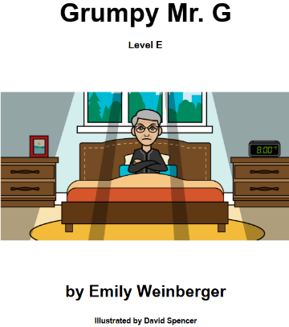
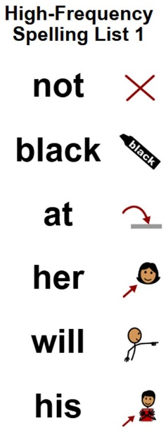
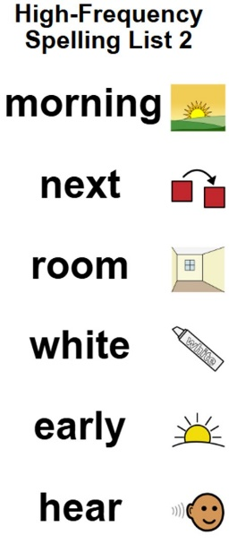
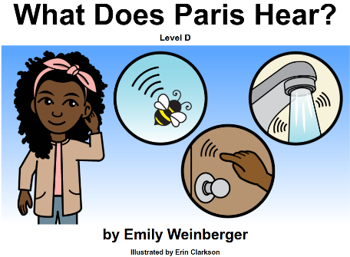
SAILS
March 2026
Spotlight on Learning
Monthly Theme
This unit introduces the concepts of light and sound. Students learn how light affects how we see things. Students will also explore sound and how it is made and amplified.
Monthly Unit Overview
March Reading
Writing - Monthly Word Study
SOCIAL STUDIES
Identify and make connections between people, events or information in a text
Organize a sequence of events or dates on a timeline.
Use time concept vocabulary to describe personal activities and schedules.
SCIENCE
Explore sounds and how they are made
Learn how light affects how they see things
MATH
Number Sense
Operations
Measurement
Graphing
Time
Money
UPCOMING EVENTS

Slide 2
ABC
March 2026
Spotlight on Learning
Monthly Theme
This unit introduces the concepts of light and sound. Students learn how light affects how we see things. Students will also explore sound and how it is made and amplified.
Monthly Unit Overview
March Reading
Writing - Monthly Word Study
SOCIAL STUDIES
Identify and make connections between people, events or information in a text
Organize a sequence of events or dates on a timeline.
Use time concept vocabulary to describe personal activities and schedules.
SCIENCE
Explore sounds and how they are made
Learn how light affects how they see things
MATH
Number Sense
Operations
Measurement
Graphing
Time
Money
UPCOMING EVENTS

